Slide 1

BARK WITH SWAG
Because a best friend is always loud

Slide 2
BARK WITH SWAG
Dogs are not our whole life, but they make our lives whole.
The more the paw buddies you have the more happiness you have.
Take care of your friend as you take care of a baby.

Slide 3

BARK WITH SWAG
We here in “BARK WITH SWAG” have wide range of your friendly paw buddies for you to ADOPT.
Benefits of adopting a paw buddy:
Dogs make us feel less alone
Dogs are good for your heart
Dogs help you stop stressing out
Dogs make us more social
Dogs make us happier

Slide 4
Portfolio:
BENEFITS:
Improved project selection process.
Better view of the big picture.
Focus on objective business goals.
Collaboration over competition.
More efficient use of resources.
More accurate project performance data.
Increased timely project deliveries.
Decreased organizational risk.
CREATION:
Choose a template
Showcase your best project. Use high quality
Include the right content and features
Improve your Portfolio’s UX
Work on your site’s SEO
Make it mobile friendly
Ask for an honest feedback
Publish and promote

Slide 5
Front end:
CSS: | HTML: | JavaScript:
CSS is the language we use to style an HTML documents. CSS stands for Cascading Style Sheets CSS describes how HTML elements are to be displayed on screen, paper, or in other media CSS saves a lot of work. It can control the layout of multiple web pages all at once External stylesheets are stored in CSS files | HTML stands for Hyper Text Markup Language HTML is the standard markup language for creating Web pages HTML describes the structure of a Web page HTML consists of a series of elements HTML elements tell the browser how to display the content HTML elements label pieces of content such as "this is a heading", "this is a paragraph", "this is a link", etc | It is a lightweight, interpreted, or just-in-time compiled programming language with first-class functions. While it is most well-known as the scripting language for Web pages, many non-browser environments also use it Such as Node.js, Apache CouchDB and Adobe Acrobat. JavaScript is a prototype-based, multi-paradigm, single-threaded, dynamic language, supporting object-oriented, imperative, and declarative

Slide 6
AZURE:
The Azure cloud platform is more than 200 products and cloud services designed to help you bring new solutions to life—to solve today’s challenges and create the future. Build, run and manage applications across multiple clouds, on-premises and at the edge, with the tools and frameworks of your choice.
Microsoft Azure, formerly known as Windows Azure, is Microsoft's public cloud computing platform. It provides a range of cloud services, including compute, analytics, storage and networking. Users can pick and choose from these services to develop and scale new applications, or run existing applications in the public cloud.
The Azure platform aims to help businesses manage challenges and meet their organizational goals. It offers tools that support all industries -- including e-commerce, finance and a variety of Fortune 500 companies -- and is compatible with open source technologies. This provides users with the flexibility to use their preferred tools and technologies. In addition, Azure offers 4 different forms of cloud computing: infrastructure as a service (IaaS), platform as a service (PaaS), software as a service (SaaS) and serverless.

Slide 7
HOW DOES IT WORK:
Once customers subscribe to Azure, they have access to all the services included in the Azure portal. Subscribers can use these services to create cloud-based resources, such as virtual machines (VM) and databases.
In addition to the services that Microsoft offers through the Azure portal, a number of third-party vendors also make software directly available through Azure. The cost billed for third-party applications varies widely but may involve paying a subscription fee for the application, plus a usage fee for the infrastructure used to host the application.
Microsoft provides five different customer support options for Azure:
Basic
Developer
Standard
Professional Direct
Premier
These customer support plans vary in terms of scope and price. Basic support is available to all Azure accounts, but Microsoft charges a fee for the other support offerings. Developer support costs $29 per month, while Standard support costs $100 per month and Professional Direct support is $1000 per month. Microsoft does not disclose the pricing for Premier support.

Slide 8


Snapshots:

Slide 9
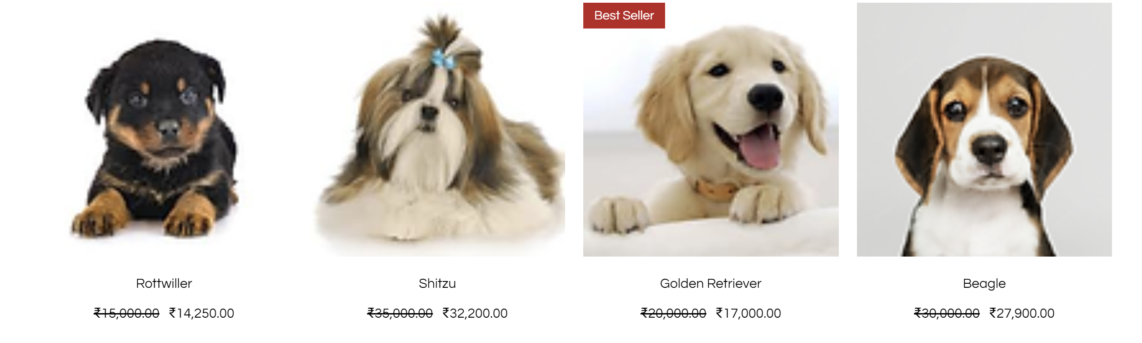

Slide 10
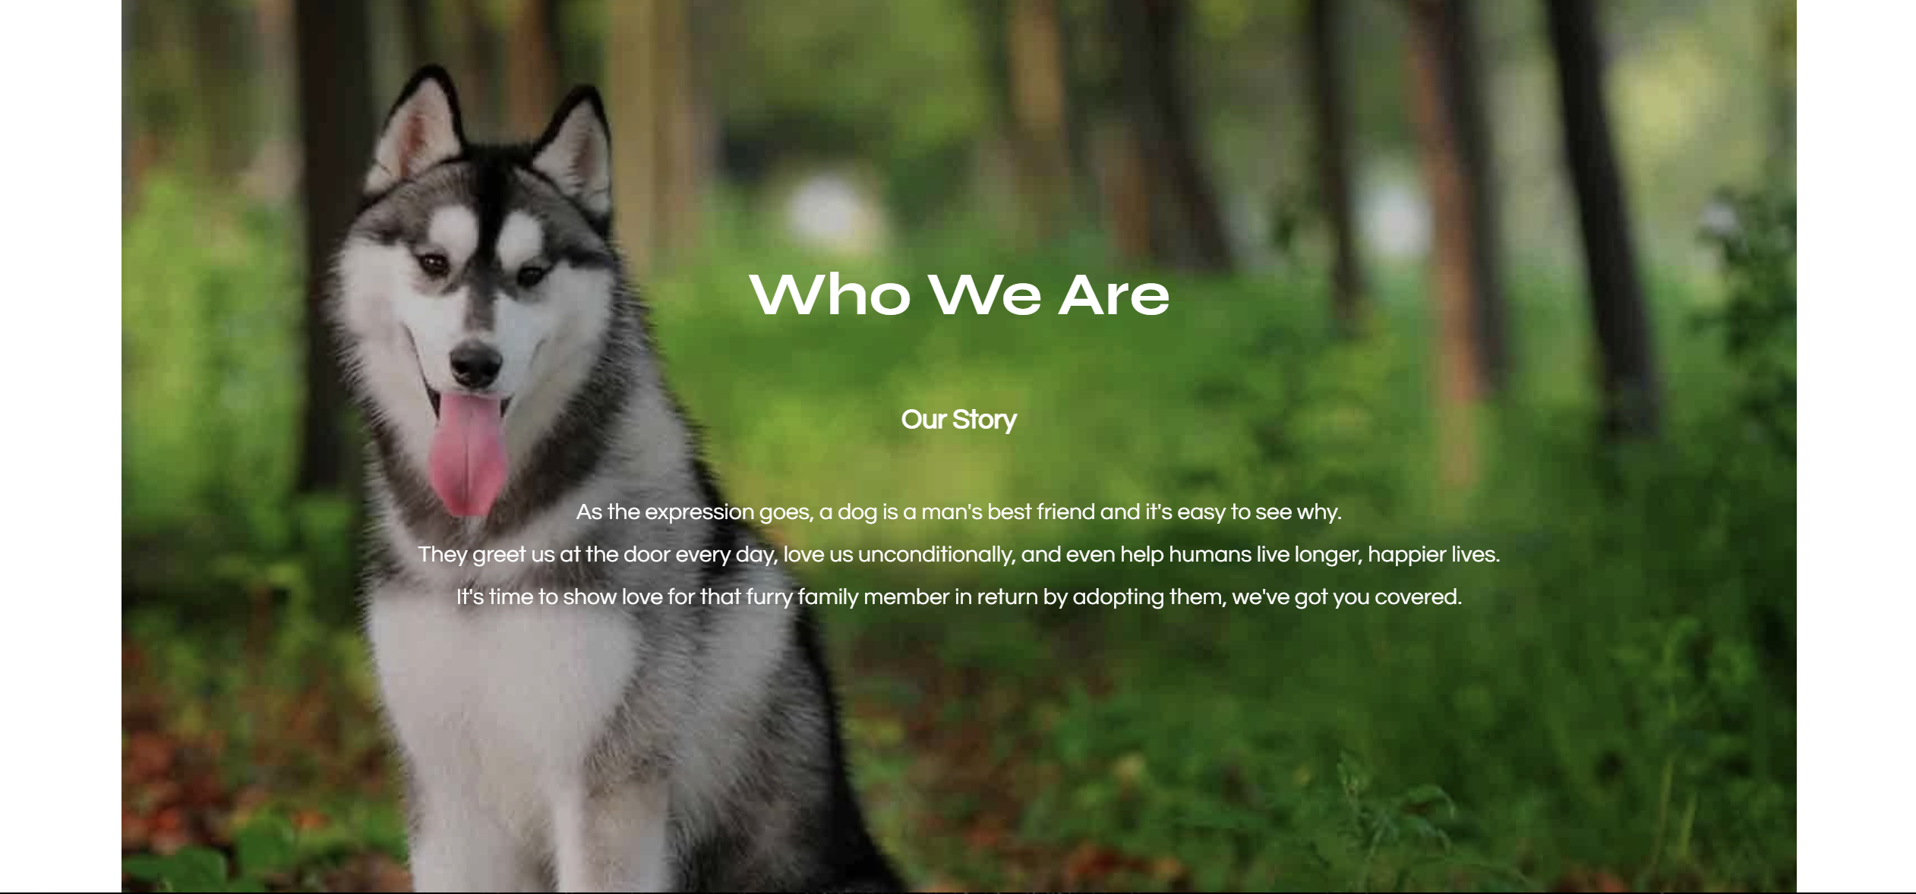

Slide 11


Slide 12


Slide 13
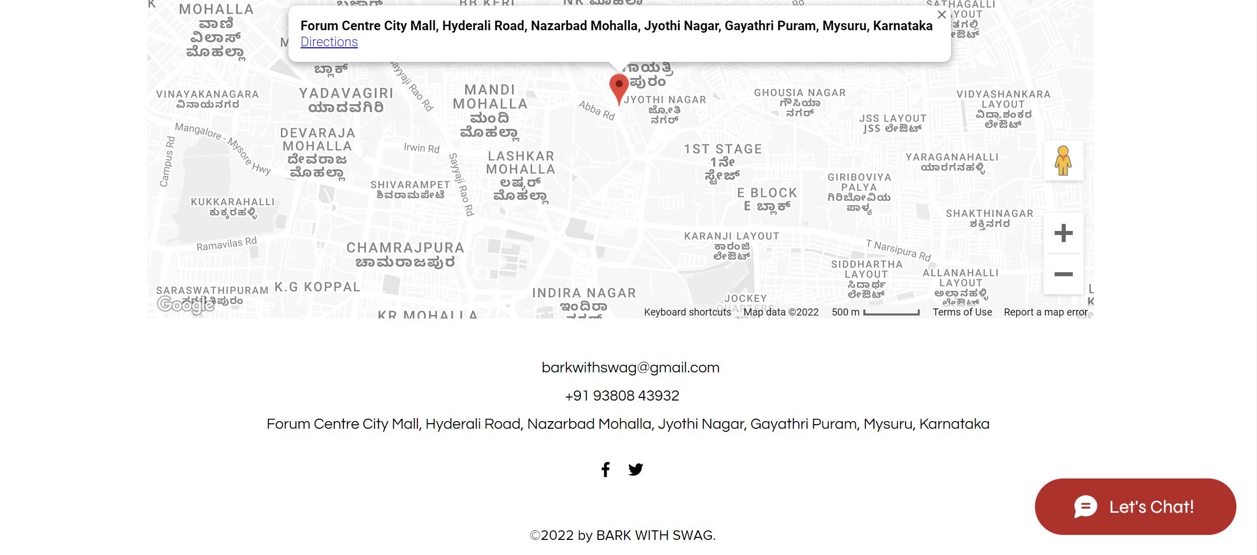

Slide 14
BARK WITH SWAG
Further details will be given
regarding “Bark with Swag” using the Portfolio
Thank you

